Slide 1
Genetic Algorithm In HLS

Slide 2
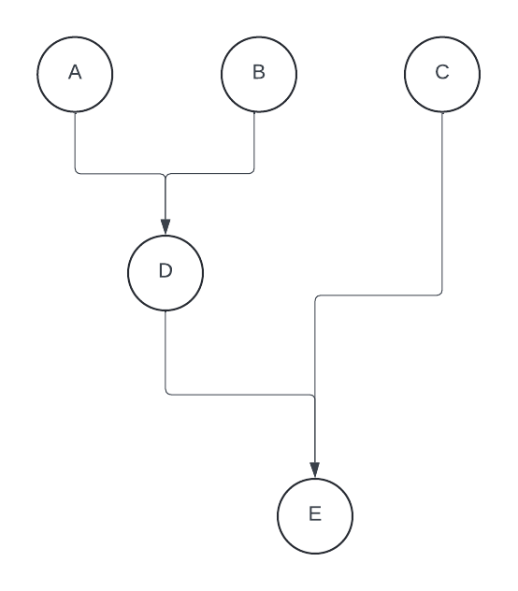
Introduction - High level synthesis
What is Synthesis.
Why is HLS needed.
How is HLS done.

Slide 3
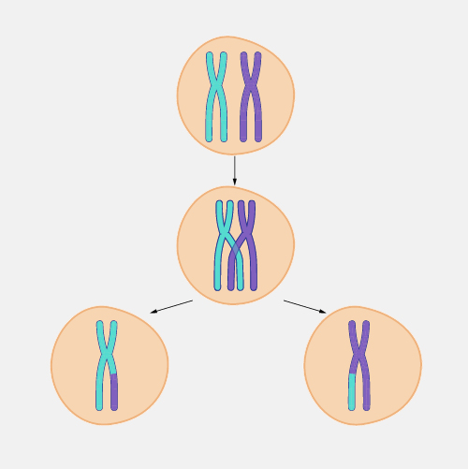
Introduction - Genetic Algorithm
Importance of Bio-mimicry.
GA as a search and optimize algorithm.
Evolution vs natural selection.
Cross-over vs mutation

Slide 4
GA implementation in HLS
Generating the first generation.
Generating the fitness function.
Applying evolution and natural selection.

Slide 5
Example

Slide 6
HDL code
module diffEqn (x, dx, u, a, clock, y) input x, dx, u, a, clock; output y; always @(posedge clock) while (x<a) begin x1=x+dx; u1=u-(3*x*u*dx)-(3*y*dx); y1=y+(u*dx); x=x1; u=u1; y=y1; end endmodule

Slide 7
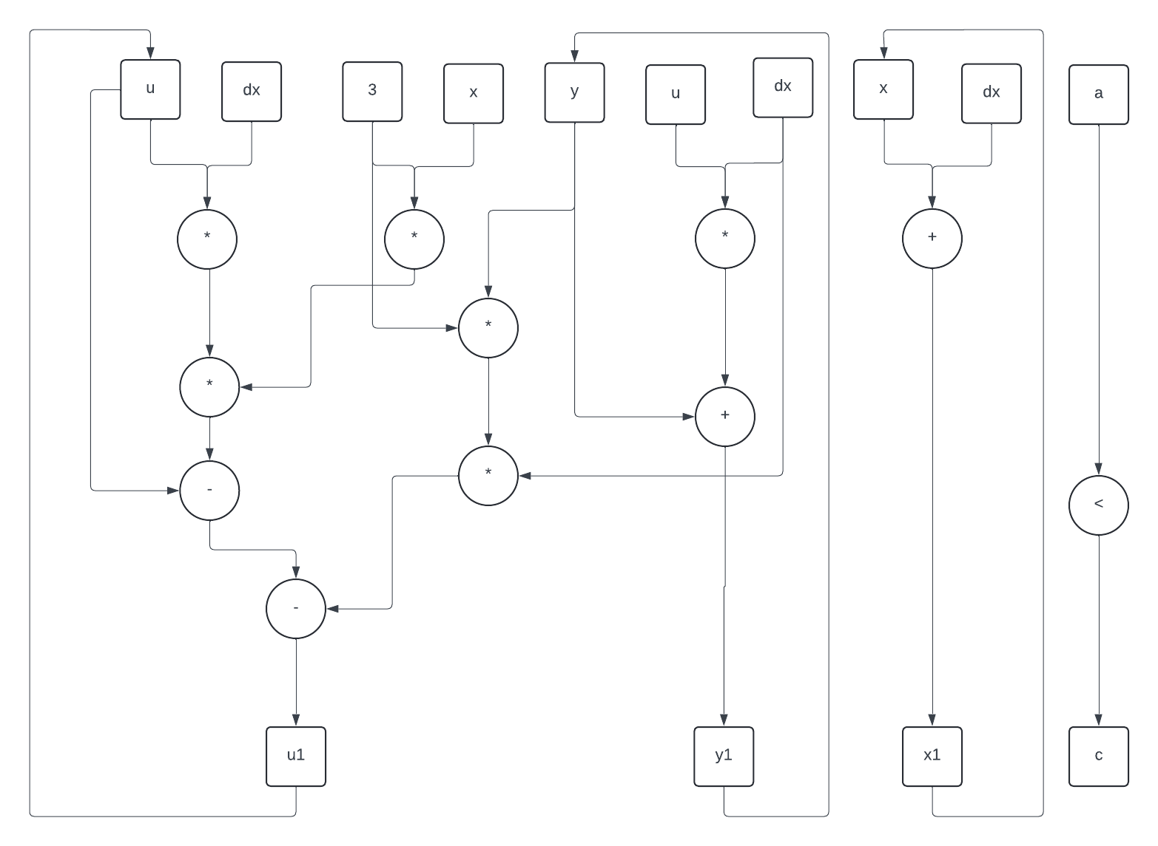
CDFG
CDFG Generated

Slide 8
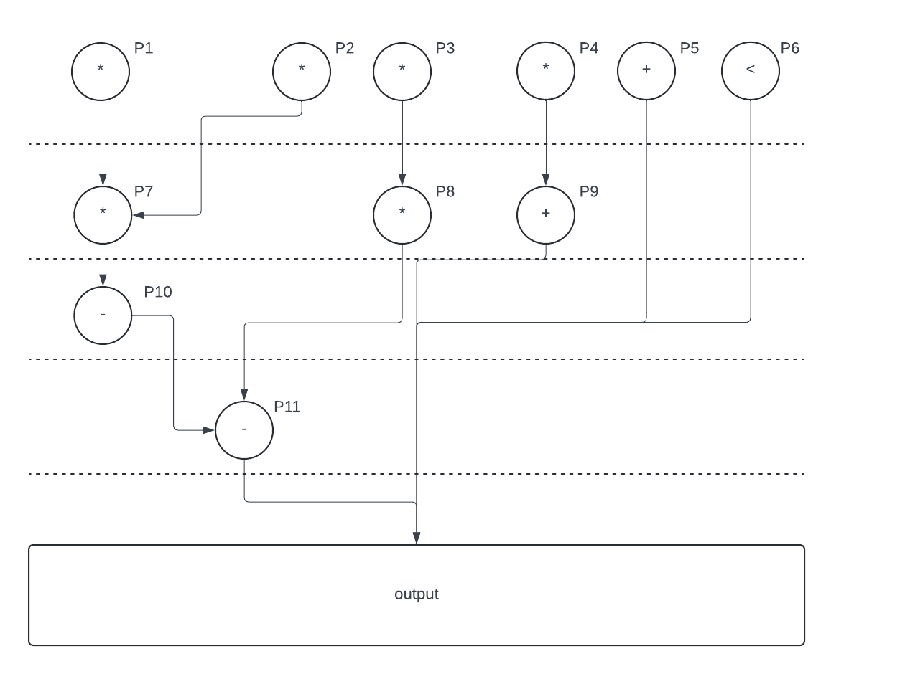
CDFG
CDFG cleaned and split into time steps

Slide 9
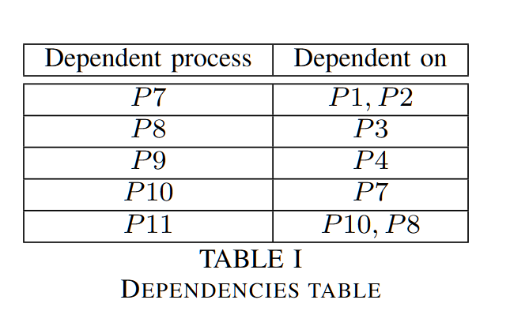
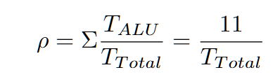
Simulation parameters
Setting constraints : 3 ALUs.
Analyzing dependencies
Setting Fitness : Maximum utilization of ALUs
Fitness equation

Slide 10
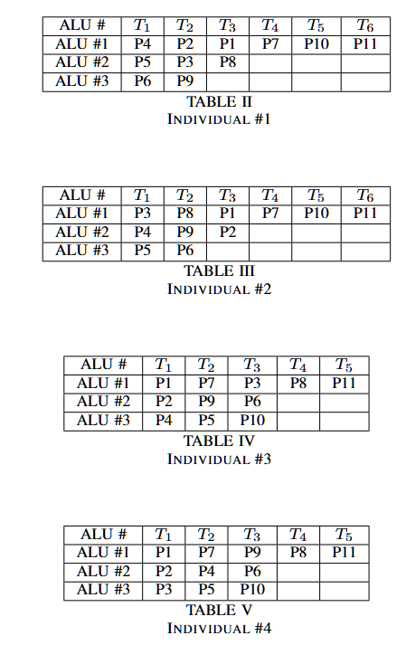
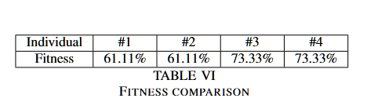
Generating first generation
Generating first population based on availability.
Evaluating their fitness.

Slide 11
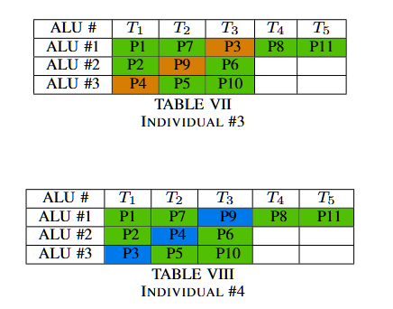
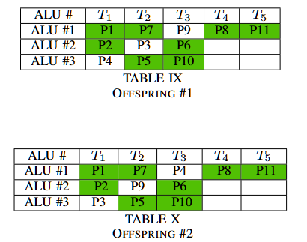
Generating second generation

Slide 12
Generating second generation

Slide 13
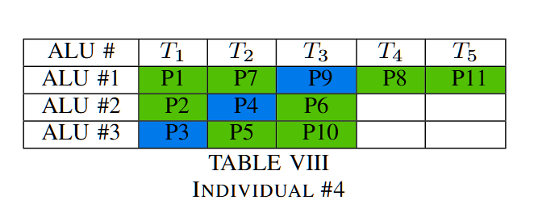
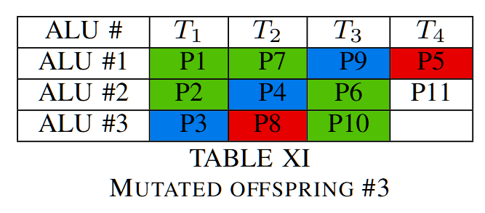
Introducing mutation

Slide 14
Conclusion

Slide 15
Conclusion
GA is flexible in fitness assertion.
Generating invalid offspring can be tolerated depending on design.
Trade-off between larger populations vs more generations.
GA can be resource intensive in larger applications.

